Slide 1
한국정보과학회 KCC2023 튜토리얼 @제주 라마다프라자 호텔
슈퍼컴퓨터에서 멀티노드기반 분산딥러닝하기
Soonwook Hwang
June 18, 2023
Korea Institute of Science and Technology Information

Slide 2
Some Motivational thoughts on large-scale DL practices on top of national supercomputing facilities
KISTI-6 /w ~600PF is coming in 2024
It is expected that several thousands of GPUs(?) are available
Is a large-scale LM (Language Model) training an exclusive(?) task that can be conducted by big tech companies (e.g., Google, Meta, MS) running data center facilities?
Why is it that large-scale LM (LLM) R&D is so hard in Korea?
Lack of computing resources
Lack of datasets
Lack of skills??
What can KISTI do in contributing to large-scale LM R&D in Korea?
KISTI is uniquely positioned to running a genenal-purpose national supercomputing facilitiy in Korea
Is KISTI’s supercomputing facility easy to access for users to do large-scal distributed deep learning R&D?
What are the most significant barriers that prevent users from having access to KISTI supercomputing facilities in conducting large-scale distributed training?
Is it because of the tranditional batch-scheduling based service?
??

Slide 3
Distributed Training Common Practices/Routines on Supercomputers
Log in to the system
Create/Manage/Activate a virtual environment using Conda
Request a couple of GPU-nodes to develop & test DL codes in a interactive way
Submit/Execute a corresponding batch job /w requesting/feeding on hundreds of GPUs
Logout

Slide 4
Agenda
Why distributed training?
Distributed DL Approaches
Data Parallel
Parameter Server(s)
Ring AllReduce
Model Parallel
Pipeline parallel
Tensor parallel
Multi-dimensional (3D) Parallel
KISTI GPU Cluster: Neuron
Hands-on Exercises
Conda Virtual Environment
Distributed Data Parallel(DDP) using Horovod
DDP using Singularity Container

Slide 5

Deep Learning in a slide
Courtesy of Prof. Sanjeev Arora
X
f_{𝛉}(X)
Y
𝛉 : parameters
Y
(X, Y) : (Input, Label) pair of
Training data
Loss function (how well net output matched true label y on point x) Can be l₂, cross-entropy….
Objective
Gradient Descent
Stochastic GD: Estimate ∇ via small sample of training data.

Slide 6
Why Distributed Training

Slide 7
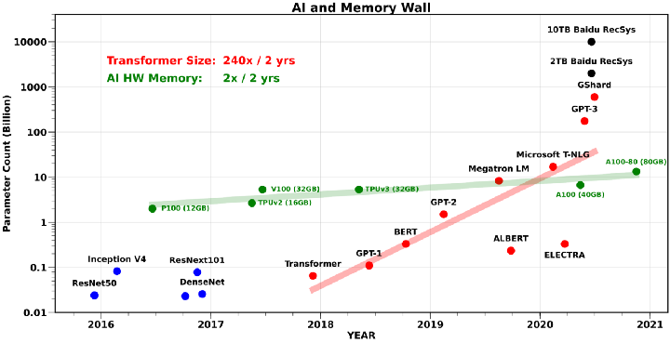
Why Distributed Training
Model size is growing too big to fit
GPT-1(‘18): 110M, GPT-2(‘19):1.5B GPT-3(’20):175B
https://medium.com/riselab/ai-and-memory-wall-2cb4265cb0b8

Slide 8
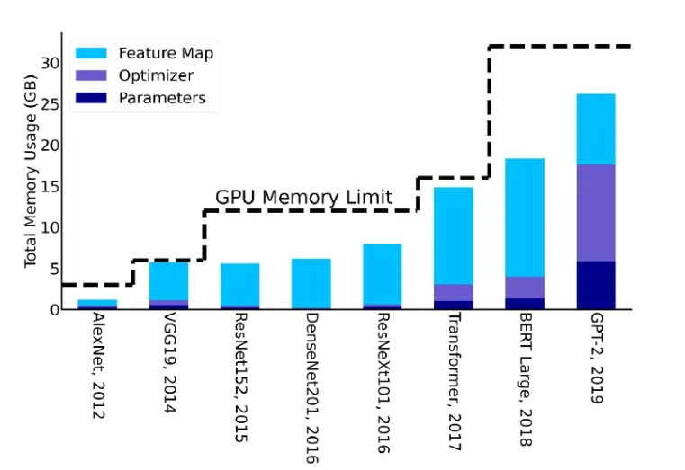
AI and Memory Wall
The amount of memory required to train different DL models
https://medium.com/riselab/ai-and-memory-wall-2cb4265cb0b8

Slide 9
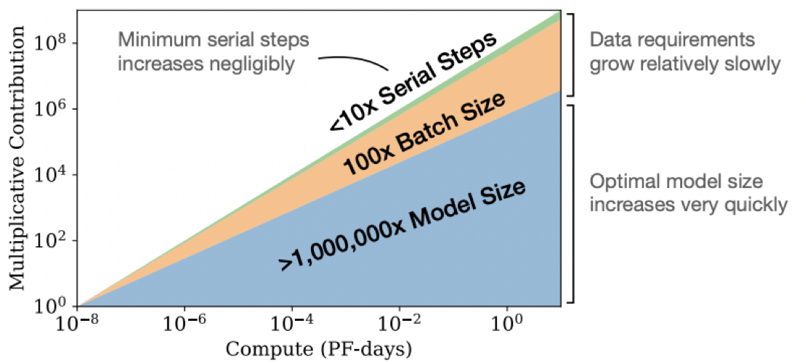
Scaling Laws
Larger models are significantly more sample-efficient
optimally compute-efficient training involves training very large models on a relatively modest amount of data and stopping significantly before convergence.
Scaling Laws for Neurral Language Models
https://arxiv.org/pdf/2001.08361.pdf

Slide 10
Why Distributed Training
With More compute power and memory using multiple devices (GPU/TPU/CPU)
Enable training large model
Speed up model training and shorten training time
Shorter training time allows you to do more experiments to reach your modeling goal

Slide 11
Scaling with Distributed Training
(Tensorflow) Training ResNet50 with ImageNet data on Neuron (A100)
/apps/applications/singularity_images/imagenet (~150G)
train #: ~1,280,000, validation #: 50,000, test #: 100,000 images
GPU #8: 10.1 min/epoch, GPU #4: 17.6 min, GPU #1: 134.7min
[gpu37] $ mpirun –np 8 python tf_keras_imagenet_resnet50.py
Epoch 1/90
5004/5004 [==============================] - 604s 118ms/step - loss: 6.5324 - accuracy: 0.0560 - top_k_categorical_accuracy: 0.1529
[gpu37] $ mpirun –np 4 python tf_keras_imagenet_resnet50.py
Epoch 1/90
10009/10009 [==============================] - 1054s 104ms/step - loss: 6.3358 - accuracy: 0.0678 - top_k_categorical_accuracy: 0.1794
[gpu37] $ mpirun –np 1 python tf_keras_imagenet_resnet50.py
Epoch 1/90
40037/40037 [==============================] - 8081s 202ms/step - loss: 6.0712 - accuracy: 0.0817 - top_k_categorical_accuracy: 0.2053

Slide 12
Scaling with Distributed Training
(Pytorch) Training ResNet50 with ImageNet data on Neuron
/apps/applications/singularity_images/imagenet (~150G)
train #: ~1,280,000, validation #: 50,000, test #: 100,000 images
GPU #8: 15.04 min/epoch, GPU #4: 28.19 min, GPU #1: 134.7min
[gpu37] $ mpirun –np 8 python pytorch_imagenet_resnet50.py
Train Epoch #1: 100%|██████████| 5005/5005 [15:26<00:00, 5.40it/s, loss=5.63, accuracy=5.33]
[gpu37] $ mpirun –np 4 python pytorch_imagenet_resnet50.py
Train Epoch #1: 100%|██████████| 10010/10010 [28:19<00:00, 5.89it/s, loss=5.53, accuracy=6.03]
[gpu37] $ python tf_keras_imagenet_resnet50.py
Epoch 1/90
40037/40037 [==============================] - 8081s 202ms/step - loss: 6.0712 - accuracy: 0.0817 - top_k_categorical_accuracy: 0.2053

Slide 13
Distributed DL Approaches

Slide 14
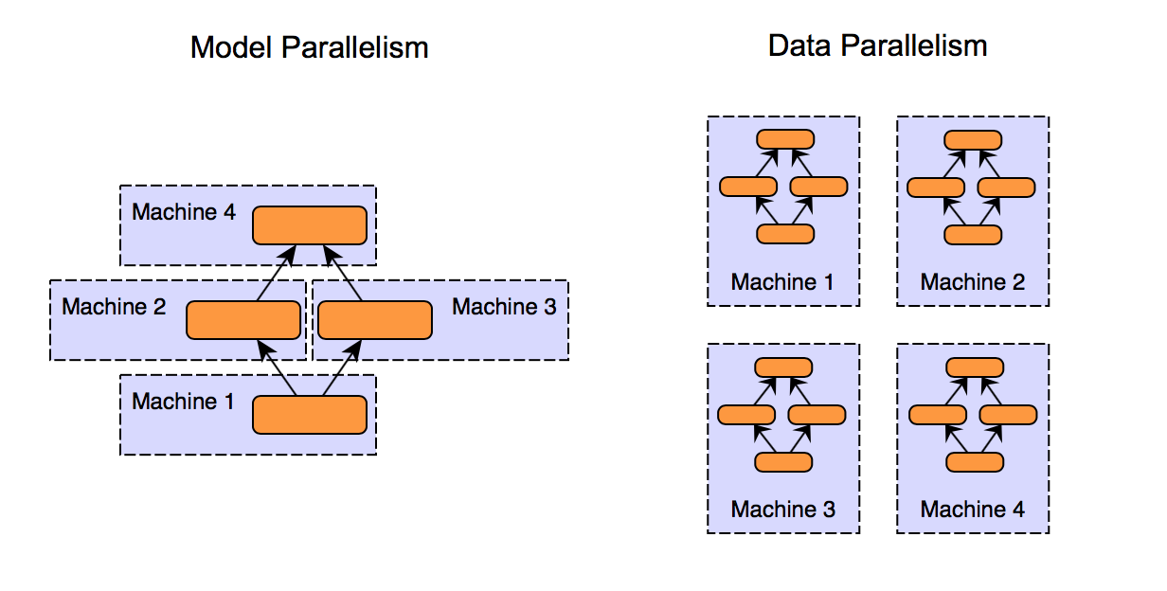
Distributed DL approaches
Different parts of model running on multiple GPUs
Model is too large, which cannot fit in a single device
Different parts of data running on multiple GPUs
Data is too large, which need to be processed in parallel

Slide 15
Data Parallel w/o Sync
Worker/device 0
Model
Forward pass
& Backprop
Gradient
Weight updates
Worker/device 1
Read Batch
& devide
by workers
Model
Forward pass
& Backprop
Gradient
Weight updates
Worker/device 2
Model
Forward pass
& Backprop
Gradient
Weight updates
How to divide/distribute batches to workers
When/How to synchoronize workers
How to maintain consistency in states

Slide 16
Data Parallel
Worker 0
Model
Forward pass
& Backprop
Gradient
Averaged
Gradient
Weight updates
Worker 1
Read Batch
& devide
by workers
Model
Forward pass
& Backprop
Gradient
Averaged
Gradient
Average gradients
& Sync workers
Weight updates
Worker 2
Model
Forward pass
& Backprop
Gradient
Averaged
Gradient
Weight updates

Slide 17
How to synchronize model parameters
Parameter Server (centralized)
Synchronous
Asynchronous
Sync AllReduce (decentralized)

Slide 18
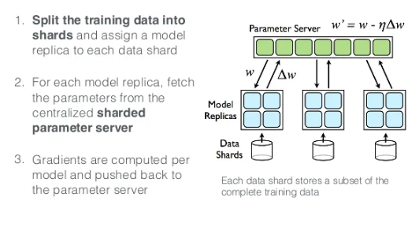
Parameter Server (PS)

Slide 19
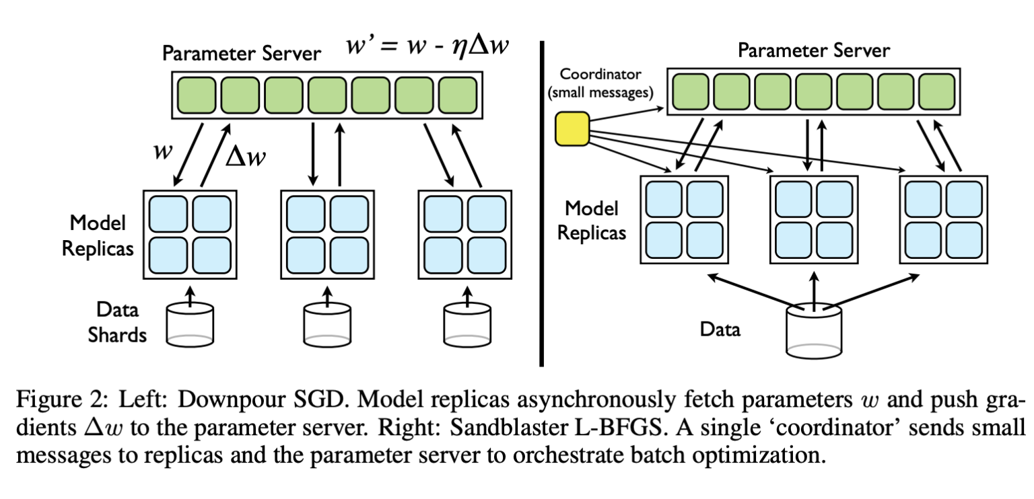
Asynchronous vs. Synchronous PS
Downpour SGD:
Online Asynchronous Stochastic
Gradient Descent
Sandblaset L-BFGS:
Batch Distributed Parameter Storage
and Manupulation
Figure from Large Scale Distributed Deep Networks
https://static.googleusercontent.com/media/research.google.com/ko//archive/large_deep_networks_nips2012.pdf

Slide 20
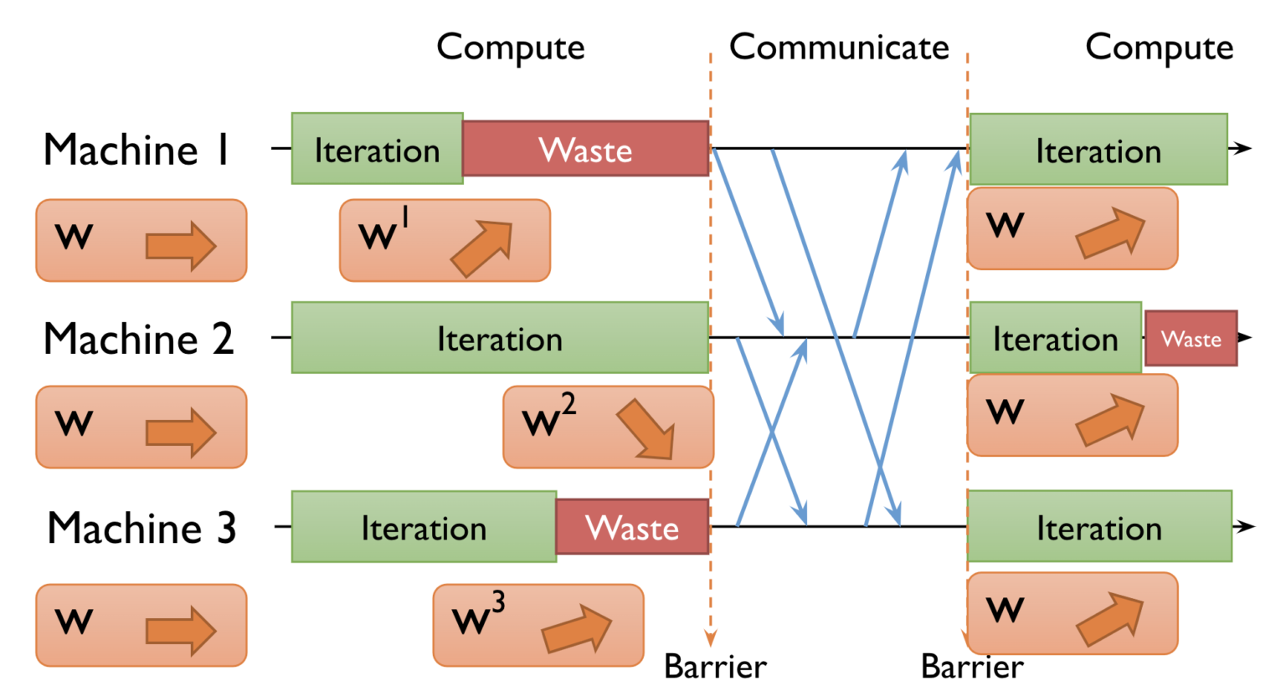
Synchronous PS
step
step
step
step
step
step
step (forward pass & backprop)

Slide 21
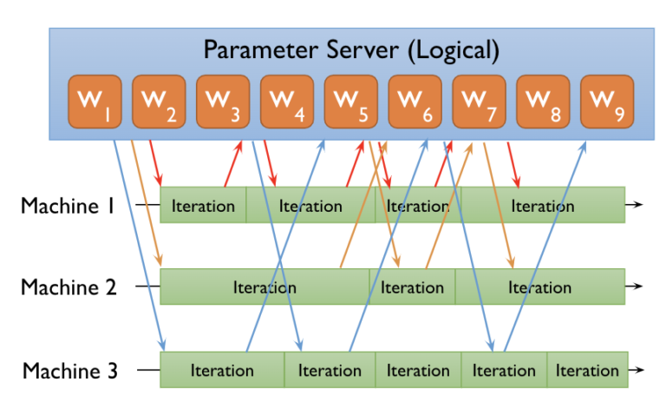
Asynchronous PS
step
step
step
step
step
step
step
step
step
step
step

Slide 22
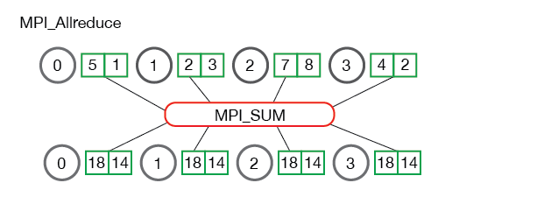
AllReduce operation
a collective communication operation that reduce a set of arrays on distributed workers to a single array that is then re-distributed back to each workers

Slide 23
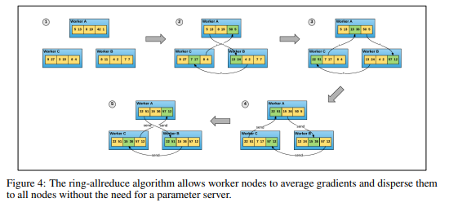
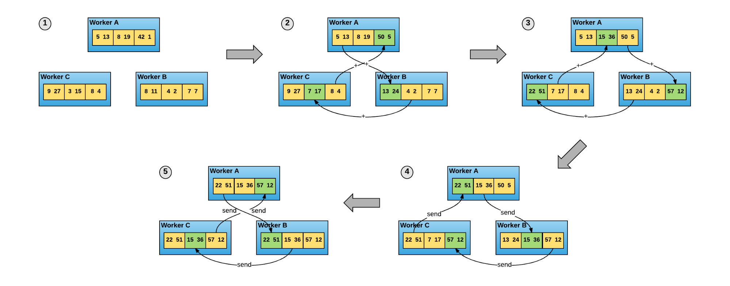
Ring AllReduce
Synchronized w/o parameter server(s)
Horovod: fast and easy distributed deep learning in Tensorflow
https://arxiv.org/pdf/1802.05799.pdf

Slide 24
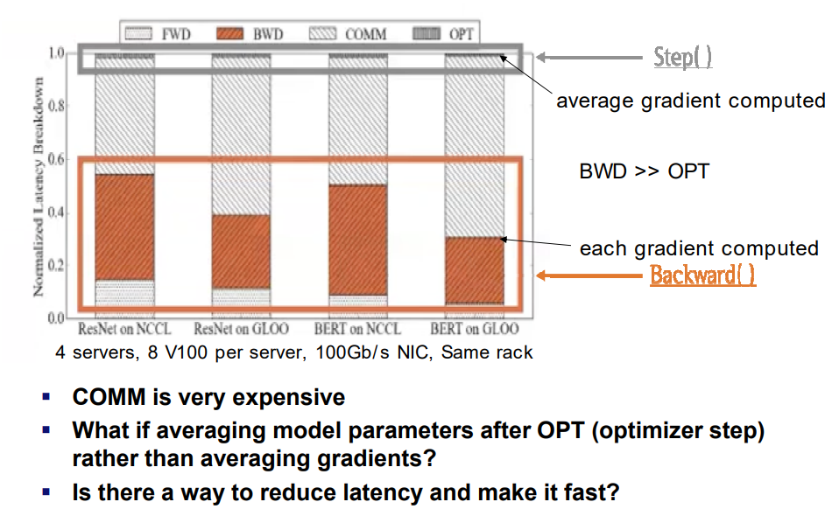
Latency Breakdown of Data Parallelism

Slide 25
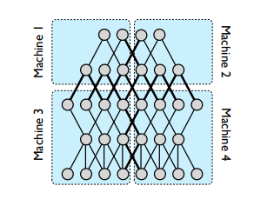
Model Parallel
Inter-layer Model Parallel
pipeline parallel
Intra-layer Model Parallel
Tensor parallel
Multi-dimensional Parallel
3D parallel

Slide 26
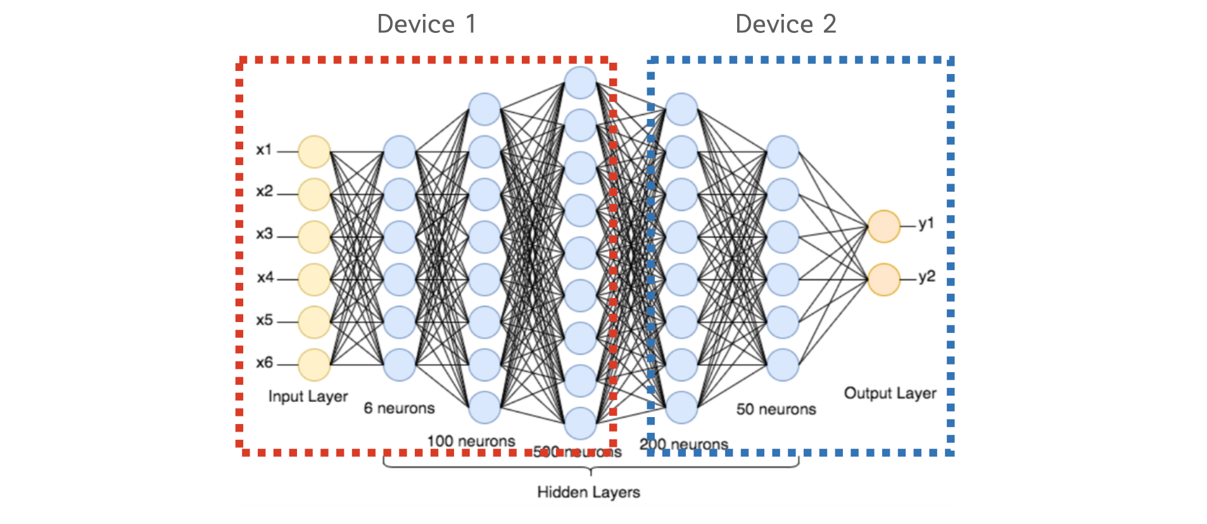
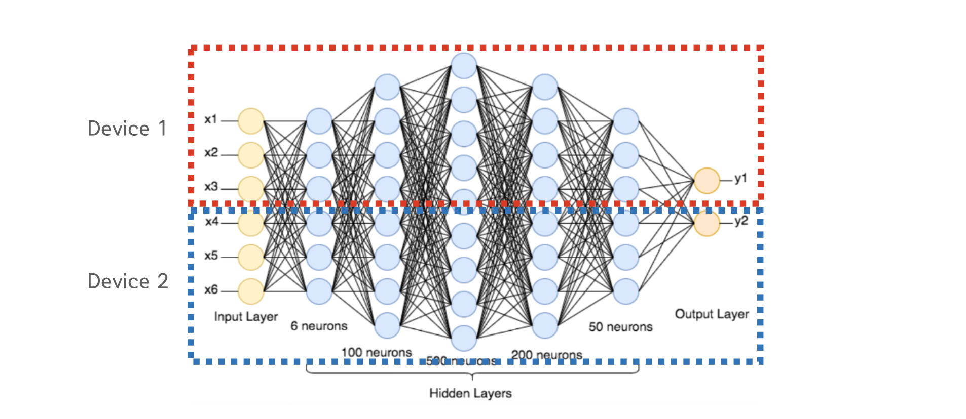
Inter/Intra-layer Model Parallel
Inter-layer
model parallel
Intra-layer
model paralle

Slide 27
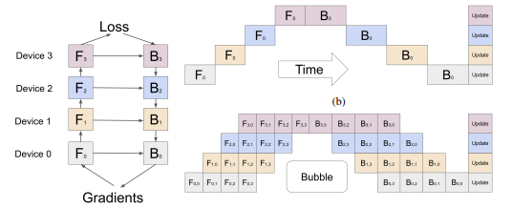
Pipeline Model Parallel
GPipe: Easy Scaling with Micro-Batch Pipeline Parallelism
https://arxiv.org/pdf/1811.06965.pdf
PipeDream: Fast and Efficient Pipeline Parallel DNN Training
https://arxiv.org/pdf/1806.03377.pdf

Slide 28
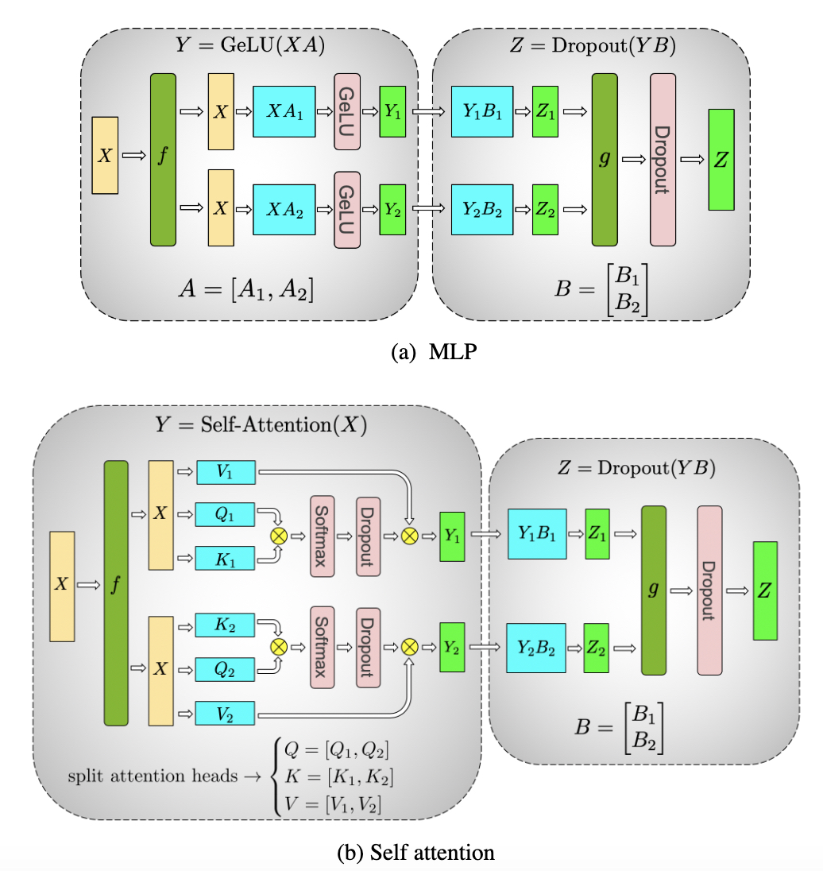
Tensor Parallel
Megatron-LM: Training Multi-Billion Parameter Language Models Using Model Parallelism
https://arxiv.org/pdf/1909.08053.pdf

Slide 29
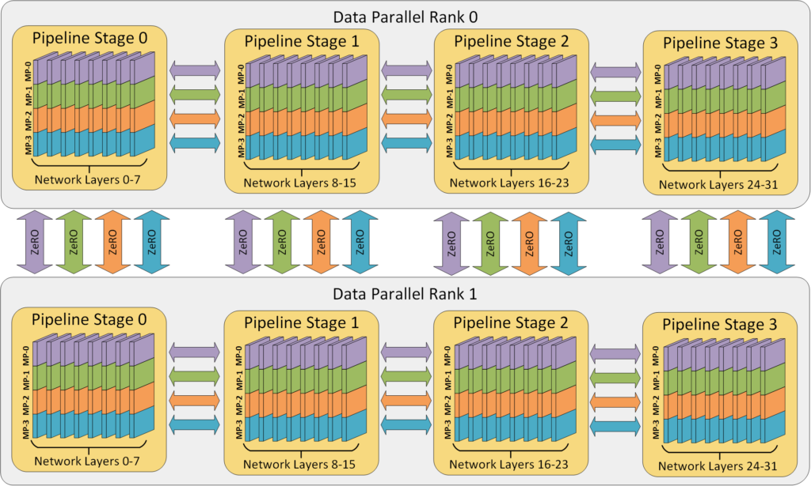
3D Parallel
Data Parallel + Pipeline Parallel + Tensor Parallel
32 workers (2DP x 4PP x 4TP)
DeepSpeed: Extreme-scale model training for everyone
https://www.microsoft.com/en-us/research/blog/deepspeed-extreme-scale-model-training-for-everyone

Slide 30
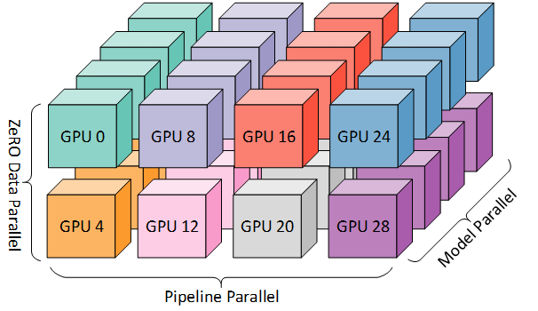
3D Parallel Example (2 x 4 x 4)
GPU 3
GPU 11
GPU 19
GPU 27
GPU 2
GPU 10
GPU 18
GPU 26
GPU 1
GPU 9
GPU 17
GPU 25
31

Slide 31
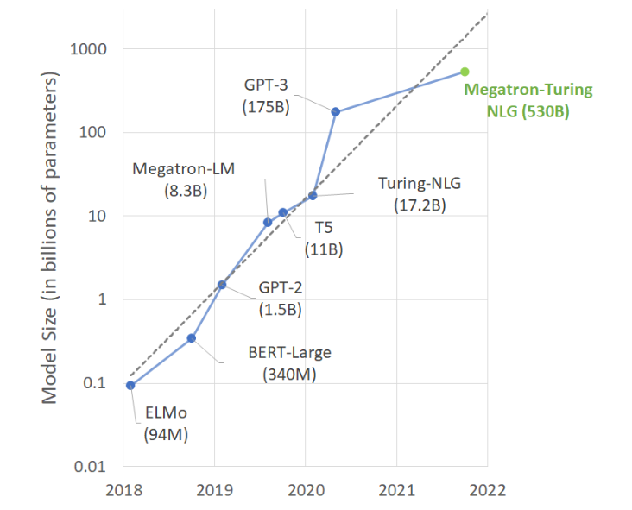
Megatron-Turing NLG (530B)

Slide 32
MT-NLG
Based on NVIDIA Megatron + MS DeepSpeed
Trained on the NVIDIA DGX SuperPOD-based Selene supercomputer
powered by 560 DGX A100 servers networked with HDR InfiniBand
3D parallel system
8-way tensor slicing within node
35-way pipeline parallelism across nodes
2-way data parallelism
Transformer-based 530 bilion parameters
# of layers: 105
# of hidden dimensions: 20480
# of attention heads: 128
Sequence length: 2048
Global Batch size: 1920
NVIDIA Technical Blog: Using DeepSpeed and Megatron to Train Megatron-Turing NLG 530B
https://developer.nvidia.com/blog/using-deepspeed-and-megatron-to-train-megatron-tur
ing-nlg-530b-the-worlds-largest-and-most-powerful-generative-language-model/

Slide 33
KISTI GPU Cluster: Neuron

Slide 34
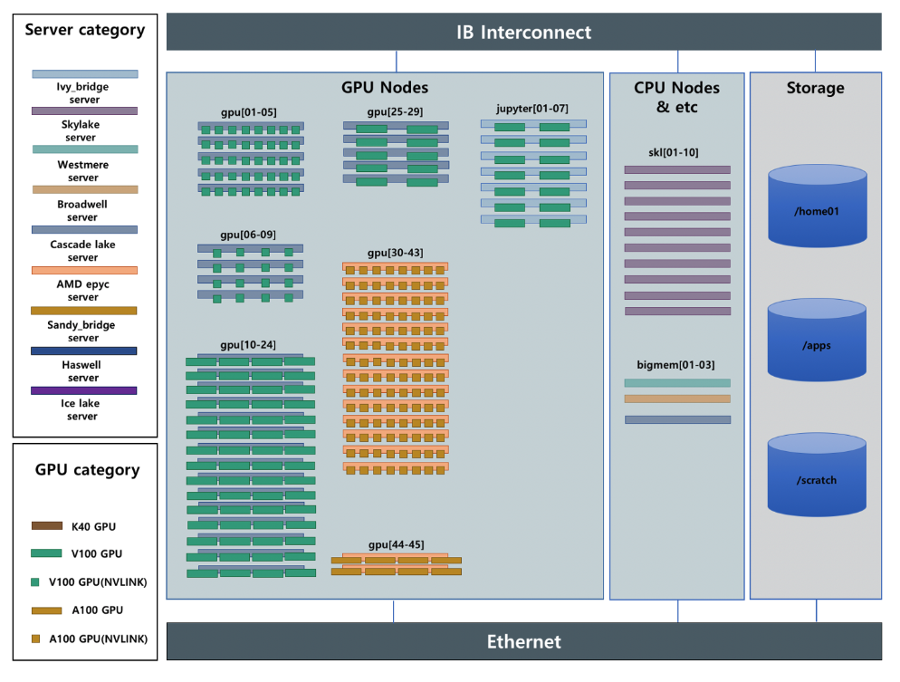
KISTI GPU Cluster: Neuron
year | #node | #GPU | #Flops
2018 | 44 | 53 | 312.8TF
2019 | 63 | 99 | 698.8TF
2020 | 78 | 163 | 1.24PF
2021 | 59 | 200 | 2.34PF
2022 | 65 | 260 | 3.53PF

Slide 35
Slurm Queues on Neuron
Queue Name (CPU_GPU_GPU#) | #Node | #Total CPU Core | #Job Submission Limit per User | #GPU allocation Limit per User
cas_v100nv_8 | 5 | 160 | 2 | 40 | V100 (NVlink) 8ea
cas_v100nv_4 | 4 | 160 | 2 | 16 | V100 (NVlink) 4ea
cas_v100_4 | 15 | 600 | 4 | 40 | V100 4ea
cas_v100_2 | 5 | 160 | 2 | 10 | V100 2ea
amd_a100nv_8 | 14 | 868 | 4 | 64 | A100 (Nvlink) 8ea
amd_a100_4 | 2 | 128 | 1 | 8 | A100 4ea
amd_a100_2 | 2 | 128 | 1 | 4 | A100 2ea
skl | 10 | 360 | 2 | -
bigmem | 3 | 120 | 1 | -

Slide 36
Slurm Queues & available GPUs on Neuron
$ sinfo
PARTITION AVAIL TIMELIMIT NODES STATE NODELIST
jupyter up 2-00:00:00 3 mix jupyter[02-04]
jupyter up 2-00:00:00 1 idle jupyter01
cas_v100nv_8 up 2-00:00:00 1 mix gpu01
cas_v100nv_8 up 2-00:00:00 4 alloc gpu[02-05]
cas_v100nv_4 up 2-00:00:00 1 mix gpu09
cas_v100nv_4 up 2-00:00:00 2 alloc gpu[07-08]
cas_v100_4 up 2-00:00:00 2 mix gpu[13,17]
cas_v100_4 up 2-00:00:00 10 alloc gpu[10-12,18-24]
cas_v100_4 up 2-00:00:00 2 idle gpu[14-15]
cas_v100_2 up 2-00:00:00 1 mix gpu25
cas_v100_2 up 2-00:00:00 1 alloc gpu26
amd_a100nv_8 up 2-00:00:00 2 mix gpu[36-37]
amd_a100nv_8 up 2-00:00:00 6 alloc gpu[30,32-33,39-41]
amd_a100nv_8 up 2-00:00:00 1 idle gpu42
amd_a100_4 up 2-00:00:00 1 mix gpu44
amd_a100_4 up 2-00:00:00 1 alloc gpu45
skl up 2-00:00:00 8 idle skl[01-06,08-09]
bigmem up 2-00:00:00 2 idle bigmem[01-02]
exclusive up infinite 1 mix gpu06
scidebert up infinite 1 mix gpu35
scidebert up infinite 1 alloc gpu34
new_service up infinite 4 down* bigmem03,jupyter[05-06],skl07
maintenance up infinite 6 idle gpu[16,29,31,38,43],jupyter07
Slurm Quick Start User Guide
https://slurm.schedmd.com/quickstart.html
KISTI User Guide
https://www.ksc.re.kr/gsjw/jcs/hd

Slide 37
Distributed Training Practice on Supercomputer

Slide 38
Distributed Training Practices on Neuron
Log in to the system
## create/activate a virtual environment
$ conda create -n pt_env python=3.7
$ conda activate pt_env
$ (pt_env) conda install pytorch
$ (pt_env) python train.py
Create/Manage/Activate a virtual environment using Conda
Request a couple of GPU-nodes to develop & test DL codes in a interactive way
## request 2 nodes for interactive job
$ salloc --nodes=2 --time=8:00:00 --gres=gpu:4 # available GPU-nodes allocated
## run& test ML/DL codes interactively
$ (pt_env) srun -n 8 python train_ddp.py
Submit/Execute a corresponding batch job /w requesting/feeding on hundreds of GPUs
## submit a batch job script requesting 20 nodes with 8 GPUs each node
$ (pt_env) sbatch train_ddp_script.sh
## monitor/check the job status
$ (pt_env) squeue
Logout

Slide 39
Conda Virtual Environments

Slide 40
Conda Virtual Environment
Download & Install Conda on /scratch/userID directory
Type your Conda installation directory to “/scratch/userID/miniconda3”
Conda default installation directory: $HOME/miniconda3
Type Conda init: “yes”, which will add conda init scripts to ~/.bashrc
## Miniconda
$ wget https://repo.anaconda.com/miniconda/Miniconda3-latest-Linux-x86_64.sh
$ chmod 755 Miniconda3-latest-Linux-x86_64.sh
$ ./Miniconda3-latest-Linux-x86_64.sh
$ source ~/.bashrc # set conda path
$ conda config --set auto_activate_base false
$ which conda
/scratch/$USER/miniconda3/condabin/conda
$ conda --version
conda 4.12.0
$ ls /scratch/$USER/miniconda3
./ conda-meta/ lib/ mkspecs/ qml/ ssl/
../ doc/ libexec/ phrasebooks/ resources/ translations/
bin/ envs/ LICENSE.txt pkgs/ sbin/ var/
….

Slide 41
Anaconda
Anaconda
distribution of the Python and R programming languages for scientific computing
data science, machine learning applications, large-scale data processing, predictive analytics, etc
aims to simplify package management and deployment
Conda
open source package management system and environment management system
runs on Windows, macOS, Linux and z/OS
quickly installs, runs and updates packages and their dependencies.
PIP
package installer for Python
use pip to install packages from the Python Package Index and other indexes.

Slide 42
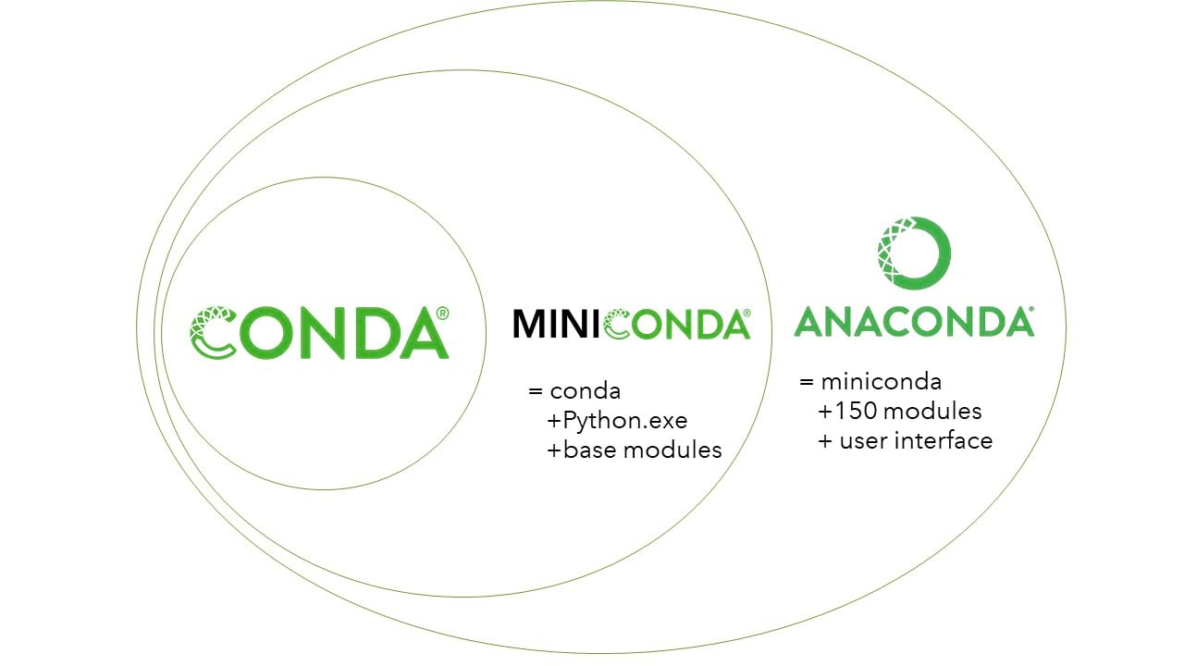
Miniconda
a small, bootstrap version of Anaconda
includes only conda, Python, the packages they depend on
a free minimal installer for conda

Slide 43
Anaconda vs Miniconda
Number of packages
Anaconda comes with over 150 data science packages, whereas miniconda comes with only a handful
Interface
Anaconda has a graphical user interface (GUI) called the Navigator, while miniconda has a command-line interface
### Anaconda Download
$ wget https://repo.anaconda.com/archive/Anaconda3-2022.10-Linux-x86_64.sh
### Miniconda Download
$ wget https://repo.anaconda.com/miniconda/Miniconda3-latest-Linux-x86_64.sh

Slide 44
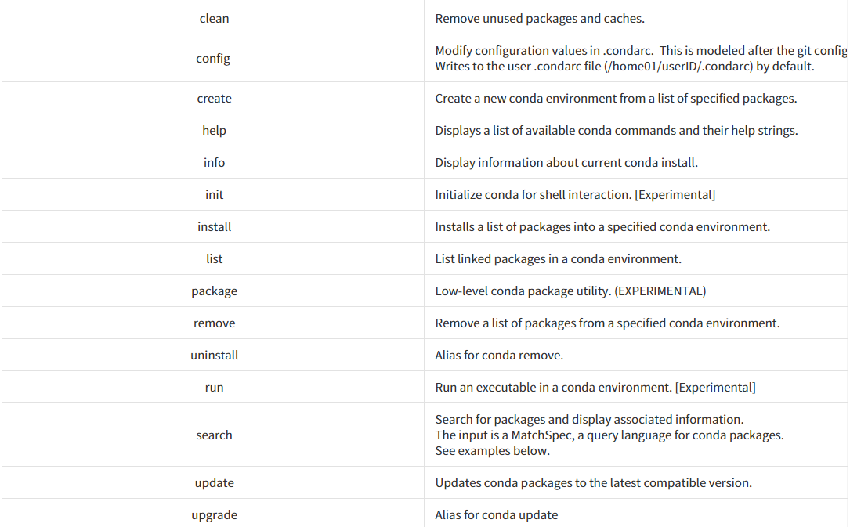
Conda command

Slide 45
Horovod Framework

Slide 46
Horovod
distributed deep learning training framework for TensorFlow, Keras, PyTorch, and Apache MXNet
developed by Uber in 2017
aims to make distributed deep learning fast and easy to use

Slide 47
Why Horovod
neutral to DL frameworks to be used
Is it possible to make your DL codes run in parallel, irrespective of whether you use Tensorflow, Keras or Pytorch frameworks?
easy to use & codify
How much modification does one have to make to a existing DL code to make it distributed?
How easy is it to run it?
fast to run
How much faster would it run in distributed mode?
how easy is it to scale up?

Slide 48
Why Horovod?
The primary motivation for this project is to make it easy to take a single-GPU training script and successfully scale it to train across many GPUs in parallel
How much modification does one have to make to a program to make it distributed, and how easy is it to run it?
How much faster would it run in distributed mode?
Internally at Uber we found the MPI model to be much more straightforward and require far less code changes than previous solutions such as Distributed TensorFlow with parameter servers.

Slide 49
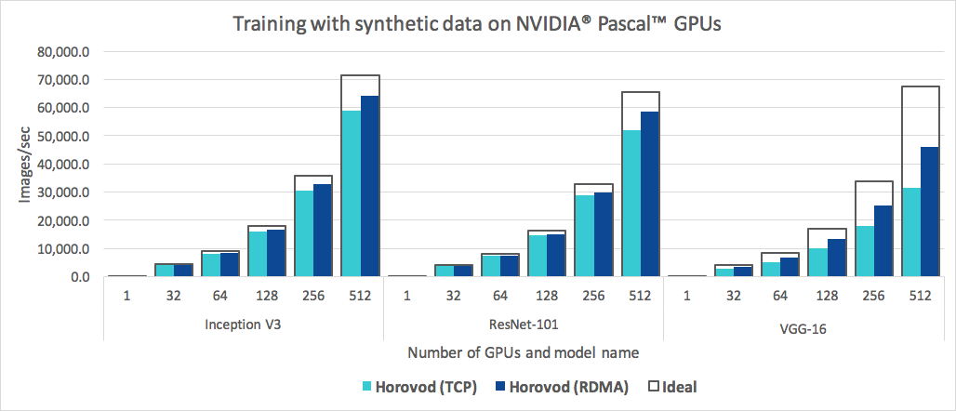
Why Horovod?
easy to use and fast
scalling with Horovod

Slide 50
Horovod Usage
5 steps/lines to be added in your code
Initialize Horovod
Pin GPU to each worker
Wrap the optimizer
Synchronize state across workers
Checkpoint on the first worker

Slide 51
Initialize Horovod
Tensorflow
import horovod.tensorflow as hvd
hvd.init()
Kera
import horovod.keras as hvd
hvd.init()
Pytorch
import horovod.torch as hvd
hvd.init()

Slide 52
Pin a GPU for each worker
Tensorflow
tf.config.experimental.set_visible_devices(gpus[hvd.local_rank()], 'GPU')
Keras
tf.config.experimental.set_visible_devices(gpus[hvd.local_rank()], 'GPU')
Pytorch
torch.cuda.set_device(hvd.local_rank())

Slide 53
Adjust learning rate and wrap the optimizer
Tensorflow
opt = tf.optimizers.Adam(0.01 * hvd.size())
opt = hvd.DistributedOptimizer(opt,…)
Keras
opt = keras.optimizers.Adadelta(0.01 * hvd.size())
opt = hvd.DistributedOptimizer(opt,…)
Pytorch
opt = optim.SGD(model.parameters(), 0.01 * hvd.size())
opt= hvd.DistributedOptimizer(opt, …)

Slide 54
Synchronize states across workers
Tensorflow/Keras
callbacks = [hvd.callbacks.BroadcastGlobalVariablesCallback(0)]
Pytorch
hvd.broadcast_parameters(model.state_dict(), root_rank=0)
hvd.broadcast_optimizer_state(optimizer, root_rank=0)
Ensure all workers start with the same weights

Slide 55
Checkpoint on the first worker (rank 0)
Tensorflow/Keras
if hvd.rank() == 0: callbacks.append(keras.callbacks.ModelCheckpoint(args.checkpoint_format))
Pytorch
if hvd.rank() == 0:
state = {'model': model.state_dict(),
'optimizer': optimizer.state_dict(), }
torch.save(state, filepath)

Slide 56
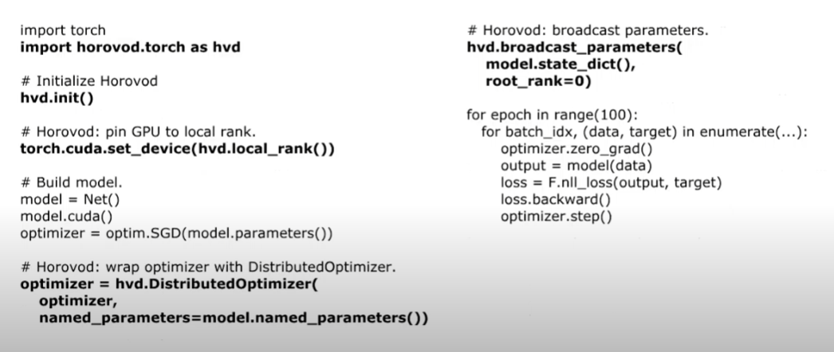
Pytorch Example

Slide 57
Horovod execution command
MPI takes care of launching processes on all nodes
Run on a node with 4-GPUs
$ salloc …
$ mpirun -np 4 -H localhost:4 python train_hvd.py
$ horovodrun -np 4 -H localhost:4 python train_hvd.py
$ srun -n python train_hvd.py
Run on 4 nodes with 4-GPUs each node
$ salloc …
$ mpirun/horovodrun -np 4 -H node1:4,node2:4,node3:4,node4:4 python train_hvd.py
$ srun -n 16 python train_hvd.py

Slide 58
Horovod Installation on Neuron
$ module load gcc/10.2.0 cuda/11.4 cudampi/openmpi-4.1.1 cmake/3.16.9
$ conda create -n horovod
$ conda activate horovod
$ conda install pytorch==1.12.0 torchvision==0.13.0 torchaudio==0.12.0 cudatoolkit=11.3 -c pytorch
$ pip install tensorflow-gpu==2.10.0
$ HOROVOD_GPU_OPERATIONS=NCCL HOROVOD_WITH_TENSORFLOW=1 HOROVOD_WITH_PYTORCH=1 \
HOROVOD_WITH_MPI=1 HOROVOD_WITH_GLOO=1 pip install --no-cache-dir horovod
$ horovodrun -cb
Horovod v0.26.1:
Available Frameworks:
[X] TensorFlow
[X] PyTorch
[ ] MXNet
Available Controllers:
[X] MPI
[X] Gloo
Available Tensor Operations:
[X] NCCL
[ ] DDL
[ ] CCL
[X] MPI
[X] Gloo

Slide 59
Horovod execution on Neuron
1) request an allocation of available on neuron
$ salloc --partition=amd_a100nv_8 -J debug --nodes=2 --time=2:00:00 --gres=gpu:4 --comment=horovod
2) load modules
$ module load gcc/10.2.0 cuda/11.4 cudampi/openmpi-4.1.1 cmake/3.16.9
3) activate the horovod virtual environment
$ conda activate horovod
4) run horovod applications
(horovod) $ mpirun/horovod -np 8 -H gpu#:4,gpu#:4 python train_hvd.py
(horovod) $ srun -n python train_hvd.py

Slide 60
Singularity Container

Slide 61
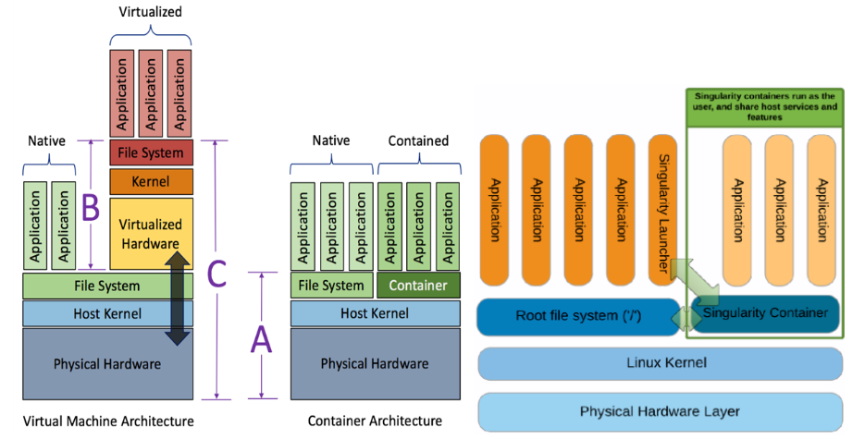
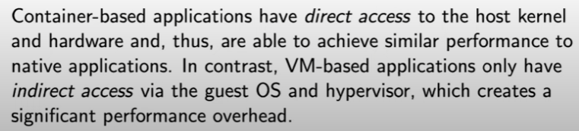
Singularity
a container platform for HPC

Slide 62
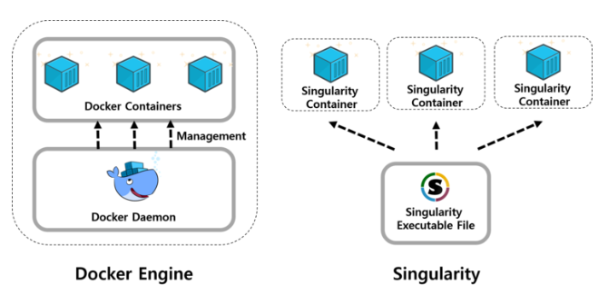
Why Singularity?
A container platform for HPC
Each container is a single image file
No root owned daemon processes
Support shared/multi-tenant resource environment
Support HPC hardware
Infiniband, GPUs
Support HPC applications
MPI

Slide 63
Running Horovod using Singularity on Neuron
No bother to deal with conda & horovod
Just allocate nodes using salloc and run singularity container. That’s it!!!
$ salloc --partition=amd_a100nv_8 -J debug --nodes=2 --time=2:00:00 --gres=gpu:4 --comment=pytorch
$ srun -n 8 singularity exec --nv /apps/applications/singularity_images/ngc/pytorch_22.03-hd-py3.sif python pytorch_imagenet_resnet50.py
/usr/bin/rm: cannot remove '/usr/local/cuda/compat/lib': Read-only file system
/usr/bin/rm: cannot remove '/usr/local/cuda/compat/lib': Read-only file system
…….
Train Epoch #10: 0%| | 1/5005 [00:13<19:03:52, 13.72s/it, loss=2.29, accurTrain Epoch #10: 0%| | 1/5005 [00:13<19:03:52, 13.72s/it, loss=2.22, accurTrain Epoch #10: 0%| | 2/5005 [00:13<19:03:38, 13.72s/it, loss=2.16, accurTrain Epoch #10: 0%| | 3/5005 [00:13<5:00:52, 3.61s/it, loss=2.16, accuraTrain Epoch #10: 0%| | 3/5005 [00:13<5:00:52, 3.61s/it, loss=2.17, accuraTrain Epoch #10: 0%| | 4/5005 [00:13<5:00:48, 3.61s/it, loss=2.23, accura
……..

Slide 64
Singularity Usage on Neuron
Web site: https://www.ksc.re.kr/gsjw/jcs/hd
job script directory
/apps/applications/singularity_images/examples
Singularity Container Images directory
/apps/applications/singularity_images/ngc
Pytorch examples directory
Single node
/apps/applications/singularity_images/examples/pytorch/resnet50v1.5
Multiple nodes
/apps/applications/singularity_images/examples/horovod/examples/pytorch
Imagenet datasets directory
Training data
/apps/applications/singularity_images/imagenet/train
Validation data
/apps/applications/singularity_images/imagenet/val

Slide 65
Github Site
KISTI Neuron cluster
https://github.com/hwang2006/KISTI-DL-tutorial-using-horovod
NERSC Perlmutter Supercomputer
https://github.com/hwang2006/distributed-training-on-perlmutter-using-horovod
Distributed Training on Supercomputer with Pytorch Lightning
https://github.com/hwang2006/distributed-training-on-supercomputer-with-pytorch-lightning
NLP Practices on Supercomputer with Pytorch Lightnign
https://github.com/hwang2006/NLP-practices-on-supercomputer-with-pytorch-lightning

Slide 66
Thank you
Contact: Soonwook Hwang <hwang@kisti.re.kr>

Slide 67
SSH Tunneling (SSH Port Forwarding)
Local Tunneling (Local Port Forward)
ssh -L localhost:8888:gpu31:21441 qualis@neuron.ksc.re.kr
Your Notebook
Supercomputer
Jupyter notebook client
Login node(s)
Computer nodes
ssh client
ssh server
Jupyter server

Slide 68
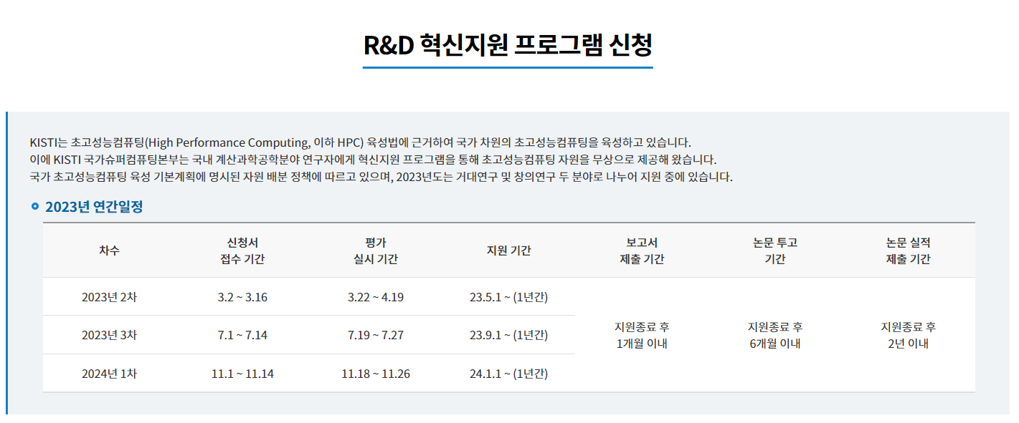
R&D혁신지원 프로그램
R&D 혁신지원프로그램 안내 및 신청
https://www.ksc.re.kr/jwjg/hsjw/hsjwan (안내)
https://www.ksc.re.kr/jwjg/hsjw/hsjwsc/list (신청)

Slide 69
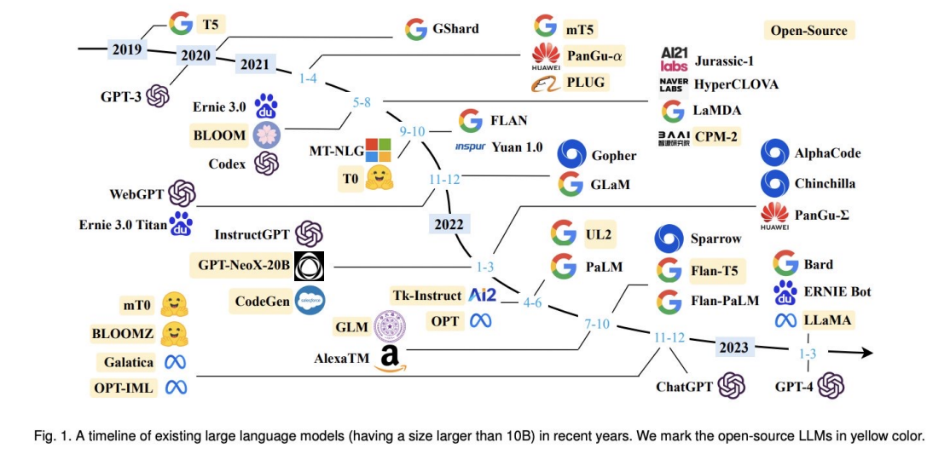
Timeline of Large Language Models (LLMs)
A Survey of Large Language Model
https://arxiv.org/pdf/2303.18223.pdf

Slide 70
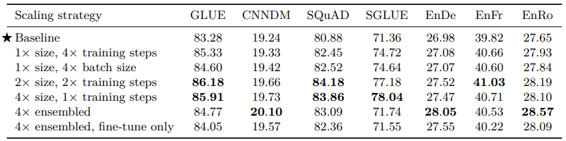
T5: Scaling
medel size matters most
Exploring the Limits of Transfer Learning with a Unified
Text-to-Text Transformer
https://arxiv.org/abs/1910.10683

